Slide 1
NN Architecture, Learning Types, Activation Functions and McCulloch-Pitts Neuron
Instructor: Dr. Mohammad Rashedur Rahman

Slide 2
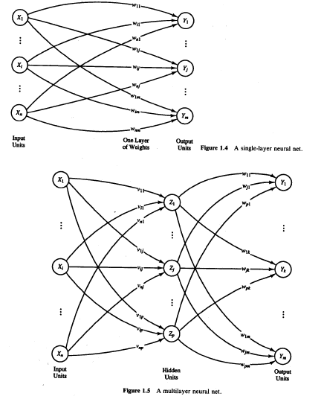
Architecture of NN
The arrangement of neurons into layers and the connection patterns within and between layers is called the net architecture.
Many neural nets have an input layer in which the activation of each unit is equal to an external input signal.
Neural nets are often classified as single layer or multilayer. In determining the number of layers, the input units are not counted as a layer, because they perform no computation.

Slide 3
Architecture of NN (Cont..)
Equivalently, the number of layers in the net can be defined to be the number of layers of weighted interconnect links between the slabs of neurons.
This view is motivated by the fact that the weights in a net contain extremely important information. The net shown in Figure 1.5 has two layers of weights.
The net illustrated in Figure 1.5 consists of input units, output units, and one hidden unit (a unit that is neither an input unit nor an output unit).

Slide 4
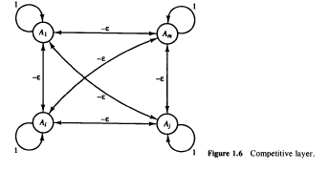
Architecture of NN (Cont..)
The single-layer and multilayer nets illustrated in Figures 1.4 and 1.5 are examples of feedforward nets-nets in which the signals flow from the input units to the output units, in a forward direction.
The fully interconnected competitive net in Figure 1.6 is an example of a recurrent net, in which there are closed-loop signal paths from a unit back to itself.

Slide 5
Architecture of NN (Cont..)
When we applied a net that was trained to classify the input signal into one of the output categories, A, B, C, D, E, J, or K,
The net sometimes responded that the signal was both a C and a K, or both an E and a K, or both a J and a K.
In circumstances such as this, in which we know that only one of several neurons should respond, we can include additional structure in the network so that the net is forced to make a decision as to which one unit will respond. The mechanism by which this is achieved is called competition.
This type of neural network is known as competitive neural network.

Slide 6
Architecture of NN (Cont..)
Winner Take All. As the name suggests, only one neuron in the competing group will have a nonzero output signal when the competition is completed. A specific competitive net that performs Winner-Take-All competition is the MAXNET.
MAXNET [Lippmann, 1987] is a specific example of a neural net based on competition. It can be used as a subnet to pick the node whose input is the largest.
The m nodes in this subnet are completely interconnected, with symmetric weights. There is no training algorithm for the MAXNET; the weights are fixed.

Slide 7
Supervised Learning
The most typical neural net setting, training is accomplished by presenting a sequence of training vectors, or patterns, each with an associated target output vector. The weights are then adjusted according to a learning algorithm.
This process is known as supervised training.
Some of the simplest (and historically earliest) neural nets are designed to perform pattern classification, i.e., to classify an input vector as either belonging or not belonging to a given category.
In this type of neural net, the output is a bivalent element, say, either 1 (if the input vector belongs to the category) or – 1 (if it does not belong).

Slide 8
Supervised Learning (Cont..)
Pattern association is another special form of a mapping problem, one in which the desired output is not just a “yes” or “no,” but rather a pattern.
A neural net that is trained to associate a set of input vectors with a corresponding set of output vectors is called an associative memory.
If the desired output vector is the same as the input vector, the net is an autoassociative memory; if the output target vector is different from the input vector, the net is a heteroassociative memory.
After training, an associative memory can recall a stored pattern when it is given an input vector that is sufficiently similar to a vector it has learned.

Slide 9
Supervised Learning (Cont..)
The single-layer nets can be used as pattern classification nets and pattern association nets and they use different types of supervised training, e.g., the Hebb rule or the delta rule.
Backpropagation (the generalized delta rule) is used to train the multilayer nets
Other forms of supervised learning are used for some of the nets in are learning vector quantization (LVQ) and counterpropagation

Slide 10
Unsupervised Learning
Self-organizing neural nets group similar input vectors together without the use of training data to specify what a typical member of each group looks like or to which group each vector belongs.
A sequence of input vectors is provided, but no target vectors are specified. The net modifies the weights so that the most similar input vectors are assigned to the same output (or cluster) unit.
The neural net will produce an exemplar (representative) vector for each cluster formed.
Kohonen self-organizing maps (SOM) is one good example of unsupervised learning.

Slide 11
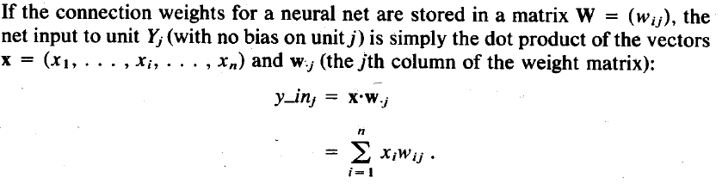
Matrix Multiplication For Calculation of Net Output

Slide 12
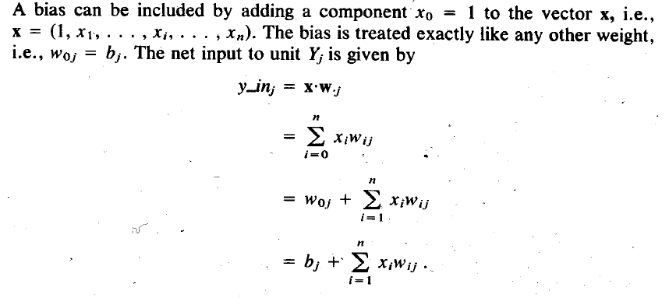
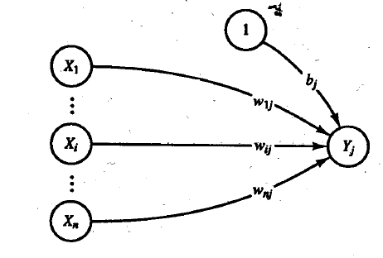
Matrix Multiplication For Calculation of Net Output with Bias

Slide 13
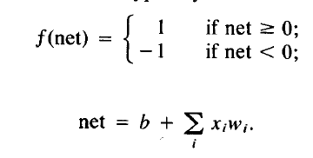
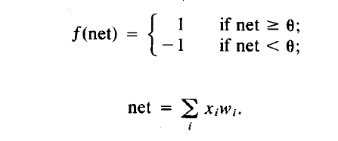
Biases and Thresholds
A bias acts exactly as a weight on a connection from a unit whose activation is always 1. Increasing the bias increases the net input to the unit.
If a bias is included, the activation function is typically taken to be
Some authors do not use a bias weight, but instead use a fixed threshold for the activation function. In that case,

Slide 14
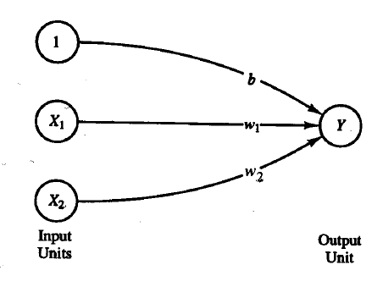
The role of Bias or Threshold
In this example we consider the separation of the input space into regions where the response of the net is positive and regions where the response is negative.
To facilitate a graphical display of the relationships, we illustrate the ideas for an input with two components while the output is a scalar

Slide 15
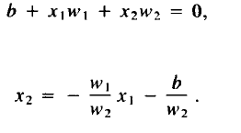
The role of Bias or Threshold (Cont..)
The boundary between the values of x1 and x2 for which the net gives a positive response and the values for which it gives a negative response is the separating line
The requirement for a positive response from the output unit is that the net input it receives, namely, b + xlw1 + X2W2, be greater than 0. During training, values of w1, w2 and b are determined so that the net will have the correct response for the training data.

Slide 16
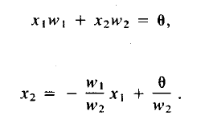
The Role of Bias or Threshold (Cont..)
If one thinks in terms of a threshold, the requirement for a positive response from the output unit is that the net input it receives, namely, x1 w1 + x2w2 , be greater than the threshold. This gives the equation of the line separating positive from negative output as
During training, values of w1 and w2 are determined so that the net will have the correct response for the training data. In this case, the separating line cannot pass through the origin.
Including neither a bias nor a threshold is equivalent to requiring the separating line (or plane or hyperplane for inputs with ‘more components) to pass through the origin. This may or may not be appropriate for a particular problem.

Slide 17
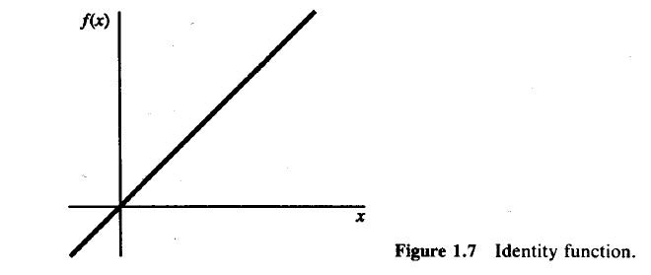
Common Activation Functions
The basic Operation of an artificial neuron involves summing its weighted input signal and applying an output, or activation function.
For the input units, this function is the identity function.
F(x)=x for all x

Slide 18
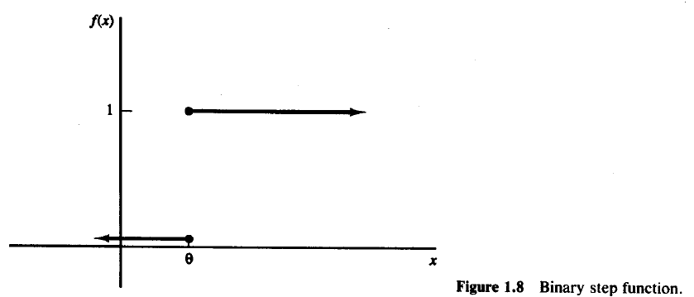
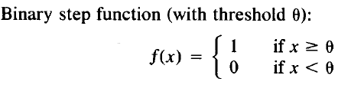
Common Activation Functions (Cont..)
Single-layer nets often use a step function to convert the net input, which is a continuously valued variable, to an output unit that is a binary (1 or 0) or bipolar (1 or - 1) signal.
The binary step function is also known as the threshold function or Heaviside function.

Slide 19
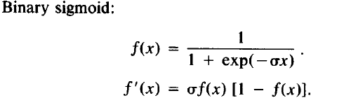
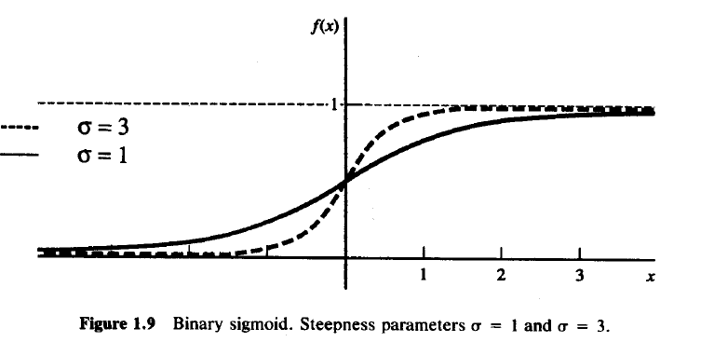
Common Activation Functions (Cont..)
Sigmoid functions (S-shaped curves) are useful activation functions.
The logistic function and the hyperbolic tangent functions are the most common.
They are especially advantageous for use in neural nets trained by backpropagation, because the simple relationship between the value of the function at a point and the value of the derivative at that point reduces the computational burden during training.

Slide 20
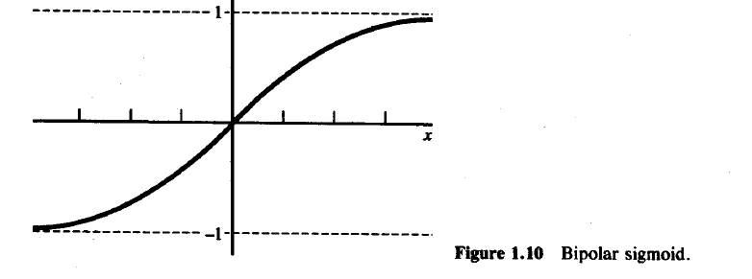
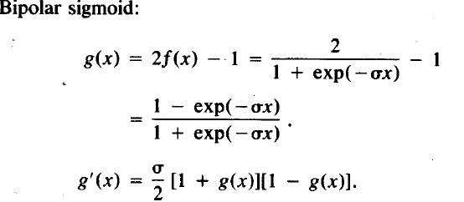
Common Activation Functions (Cont..)

Slide 21
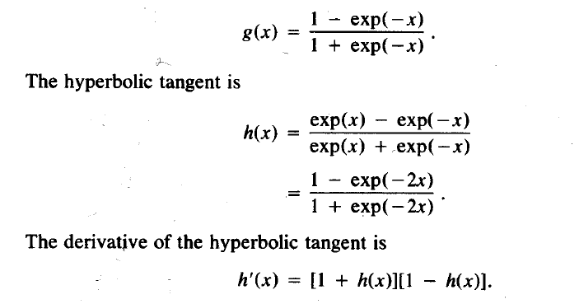
Common Activation Functions (Cont..)
The bipolar sigmoid is closely related to the hyperbolic tangent function, which is also often used as the activation function when the desired range of output values is between -1 and 1.

Slide 22
When Neural Nets Began: THE McCULLOCH-PITTS Neuron
The McCulloch-Pitts neuron is perhaps the earliest artificial neuron [McCulloch Pitts, 1943]. It displays several important features found in many neural networks.
The requirements for McCUlloch-Pitts neurons may be summarized as follows:
The activation of a McCulloch-Pitts neuron is binary. That is, at any time step, the neuron either fires (has an activation of 1) or does not fire (has an activation of 0).
2. McCulloch-Pitts neurons are connected by directed, weighted paths.

Slide 23
When Neural Nets Began: THE McCULLOCH-PITTS Neuron (cont..)
3. A connection path is excitatory if the weight on the path is positive; other-
wise it is inhibitory. All excitatory connections into a particular neuron have
the same weights.
4. Each neuron has a fixed threshold such that if the net input to the neuron
is greater than the threshold, the neuron fires.
5. The threshold is set so that inhibition is absolute. That is, any nonzero
inhibitory input will prevent the neuron from firing.
6. It takes one time step for a signal to pass over one connection link.

Slide 24
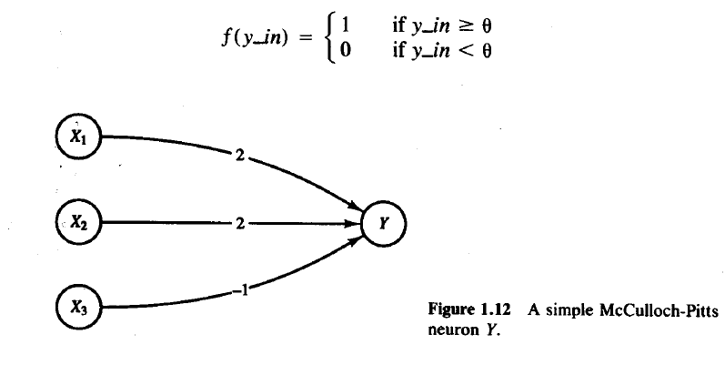
THE McCULLOCH-PITTS Architecture
In general, a McCulloch-Pitts neuron Y may receive signals from any number of other neurons.
Each connection path is either excitatory, with weight w > 0, or
inhibitory, with weight - p (p > 0).
For convenience, in Figure we assume there are n units, X1, . . . , X n, which send excitatory signals to unit Y, and m units, X _{n+1}, . . . , X _{n+m}, which send inhibitory signals.
The activation function for unit Y is given

Slide 25
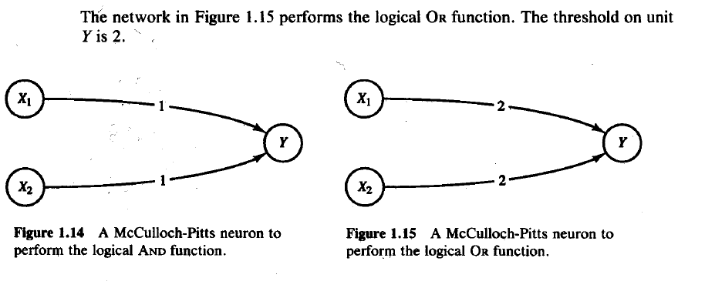
Modelling AND, OR

Slide 26
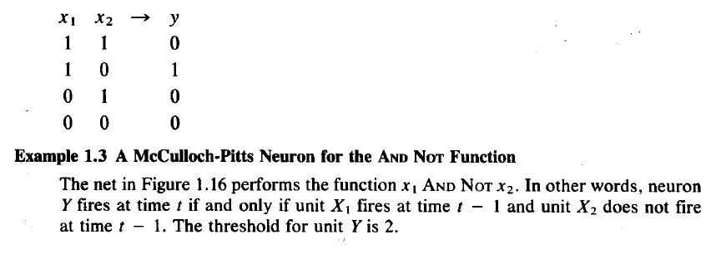
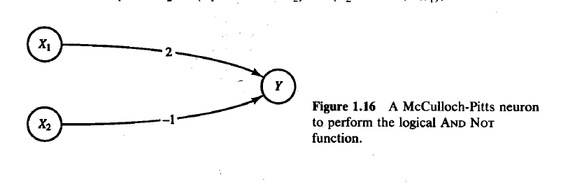
Modelling AND NOT

Slide 27
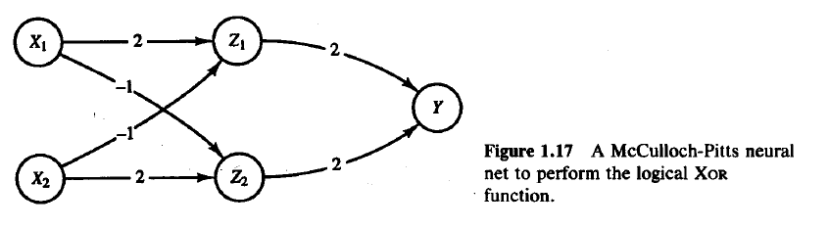
Use of AND NOT in XOR

Slide 28
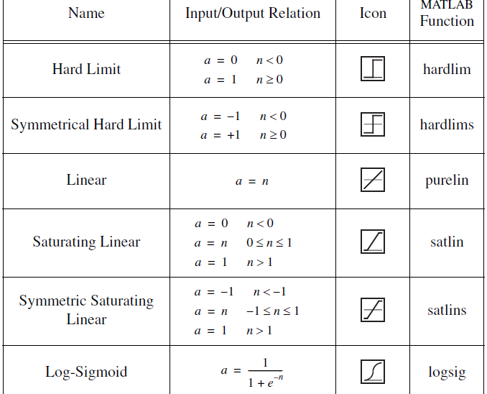
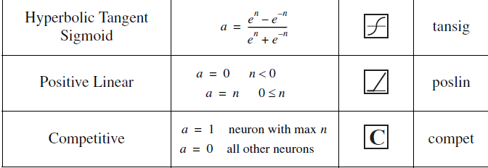
Some Activation Functions in Matlab

Slide 29
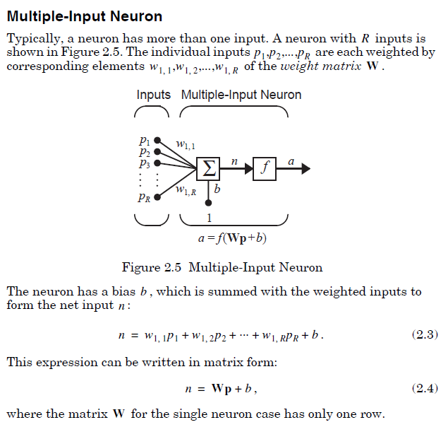
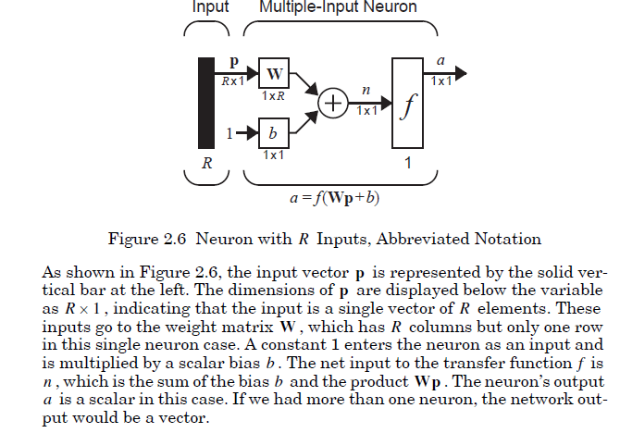
Architecture Notations in Matlab Multiple Input- Single Neuron

Slide 30
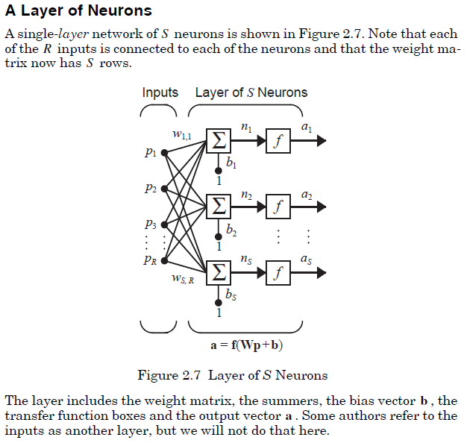
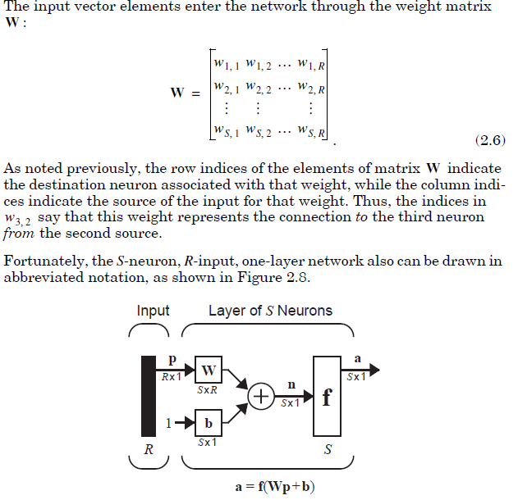
Architecture Notations in Matlab Multiple Inputs – Single layer of Multiple neurons

Slide 31
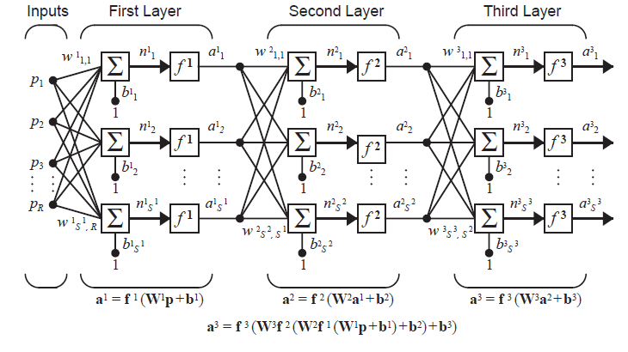
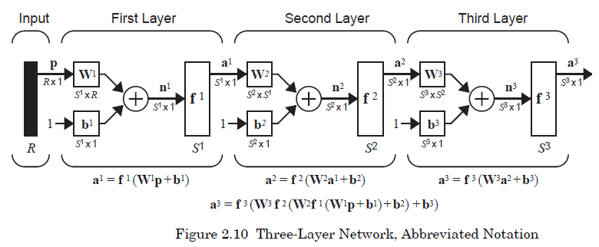
Architecture Notations in Matlab Multiple Inputs –Multiple layers of Multiple neurons

